Slide 1
Weather Forecast
Deep Learning

Slide 2
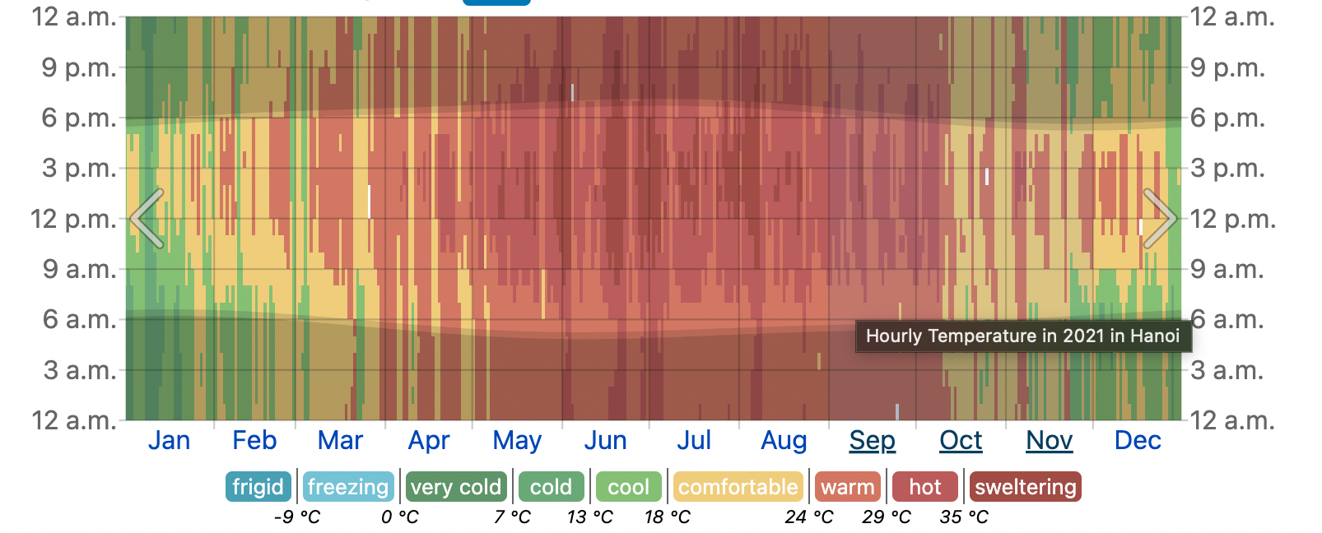
Description
Predict Temperature in Hanoi City
Using Time Series Methods

Slide 3
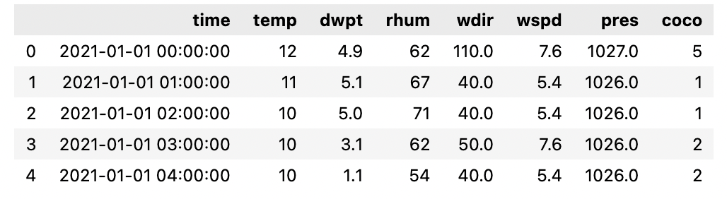
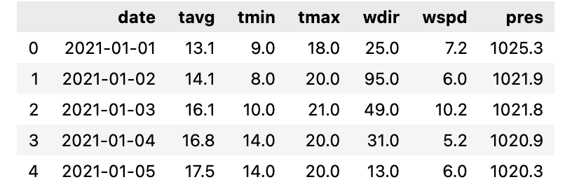
Dataset
Hanoi Weather Forecast (year 2021)
Record hourly, daily
Features:
TEMP: Air Temperature (°C)
DWPT: Dew Point
RHUM: Relative Humidity (%)
WDIR: Wind (From) Direction (Degrees)
WSPD: Average Wind Speed (km/h)
PRES: Sea-Level Air Pressure (hPa)
COCO: Weather Condition Code

Slide 4
Problem Formulation
1. Give 3 previous hours temperature → Predict 1 next hours temperature

Slide 5
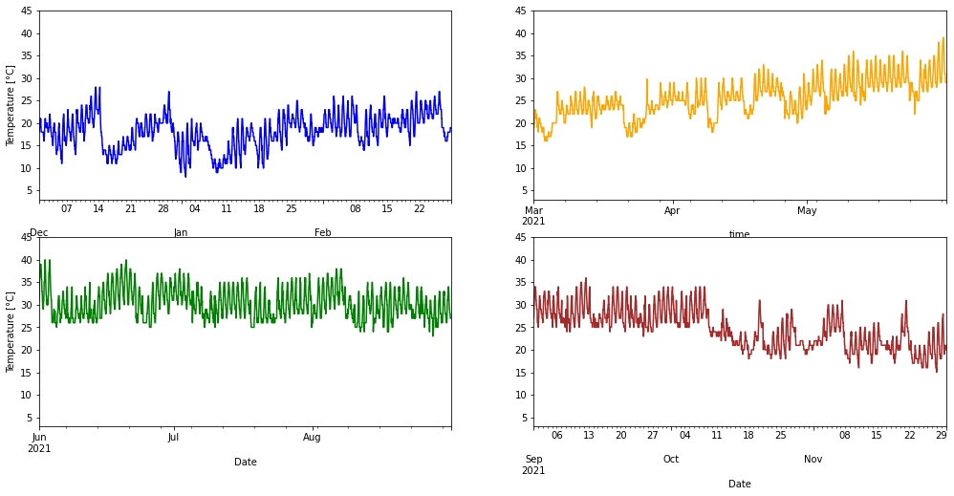
Problem Formulation
1. Give 3 previous hours temperature → Predict 1 next hours temperature

Slide 6
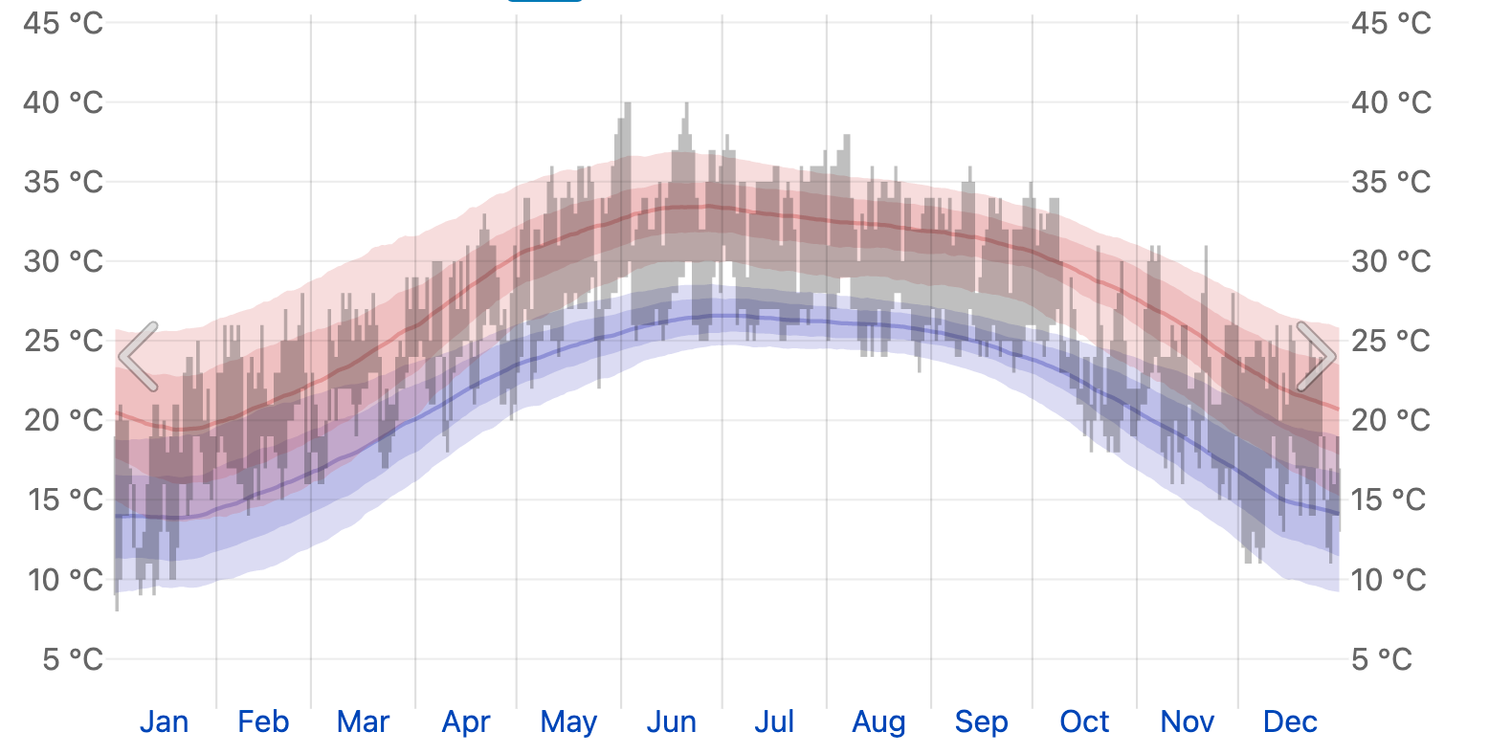
Addition: Problem Formulation
2. Give 7 previous days temperature → Predict 3 next days temperature

Slide 7
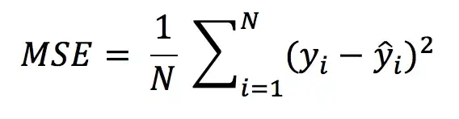
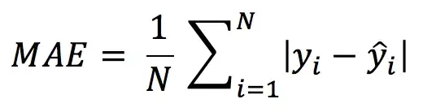
Metrics
1. Mean Square Error (MSE)
2. Mean Absolute Error (MAE)

Slide 8
Methods for Regular data
Machine Learning
ARIMA - SARIMA
Facebook Prophet
Deep Learning
RNN - LSTM - GRU
Time Series Transformer

Slide 9
Addition: Methods for Irregular data
Regular data: be generated at regularly spaced interval of time
Irregular data: be generated at non-uniform interval of time
→ Create irregular data from Hanoi Weather Forecast Dataset (regular data)
Deep Learning
Autoregressive models:
RNN (∆t, Impute, Decay, GRU-D)
CRU
ODE-RNN
Encoder-decoder models:
RNN-VAE
Latent ODE (RNN enc.), Latent ODE (ODE enc), Latent ODE + Poisson

